Slide 1
Deep Analysis Of Baltimore City Crime
Done By:
NIMIT TOLIA

Slide 2
Introduction
Data Collection
Data Preprocessing
Evaluate the model
Confusion Matrix
Data Analysis

Slide 3
Data Collection :
I had collected the Dataset from 2010 to 2022 https://data.baltimorecity.gov/datasets/baltimore::part-1-crime-data/explore
The size of the Dataset was around 800 mb
In this we have attributes :
['arrestnumber', 'age', 'gender', 'race', 'arrestdatetime', 'arrestlocation', 'incidentoffence', 'incidentlocation', 'charge', 'chargedescription', 'district', 'post', 'neighborhood', 'latitude', 'longitude', 'geolocation', 'incidentnumber', 'objectid', 'age_range']

Slide 4
Data Preprocessing
Handling missing values in the DataFrame:
Filling null values in the "arrestnumber" column with the value 'N/A'.
Filling null values in specific columns ('gender', 'race', 'arrestdatetime', etc.)
with the value 'N/A'.
Filling null values in the "age" column with the mean value of the column.
Checking for empty values in the dataset:
If the DataFrame is empty, it prints "The dataset is empty."
Otherwise, it checks for empty values in each column and prints the columns with empty values, if any.

Slide 5
Evaluate the model
Classification Model
Splitting the dataset into training and testing sets
Training a HistGradientBoostingClassifier on the dataset
Evaluating the accuracy of the model
Also we got an accuracy of 81.6%
Confusion Matrix
Generating a confusion matrix from the true and predicted race labels
Creating a visualization of the confusion matrix using a heatmap

Slide 6
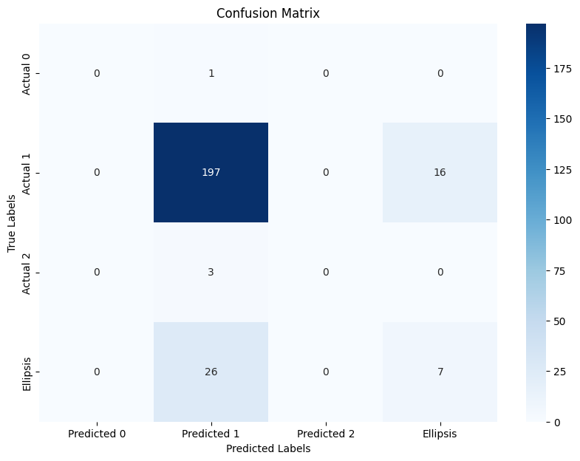
Confusion Matrix
The confusion matrix helps in understanding the performance of a classification model by providing information about true positives, true negatives, false positives, and false negatives, allowing for evaluation of the model's accuracy, precision, recall, and other metrics.

Slide 7
Data Analysis
Data analysis is the process of examining and interpreting data to uncover valuable insights and inform decision-making. It involves exploring, cleaning, transforming, and modeling data using statistical methods and tools to extract meaningful information and patterns. The ultimate objective is to derive actionable knowledge and make informed decisions based on the data.

Slide 8
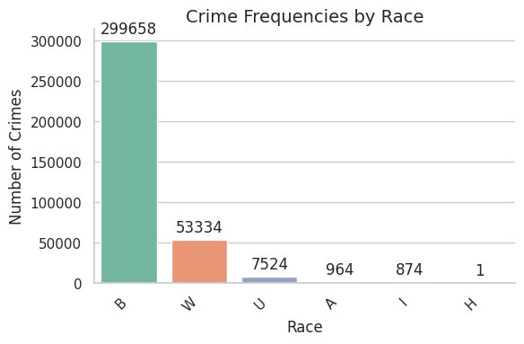
Crime Frequencies by Race
Analyzing the frequency of each race category in the dataset
Identifying the race with the highest crime frequency
Creating a bar plot to visualize race frequencies

Slide 9
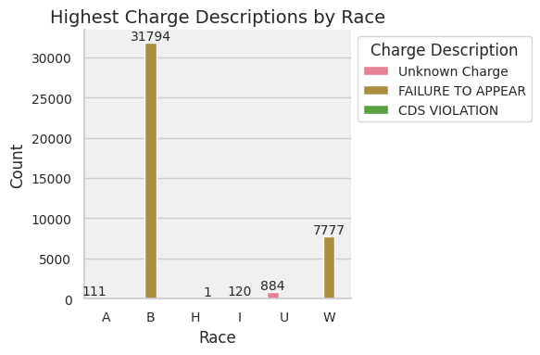
Highest Charge Descriptions by Race
Analyzing the frequency of charge descriptions for each race category
Identifying the charge descriptions with the highest count for each race category
Creating a bar plot to visualize the highest charge descriptions by race

Slide 10
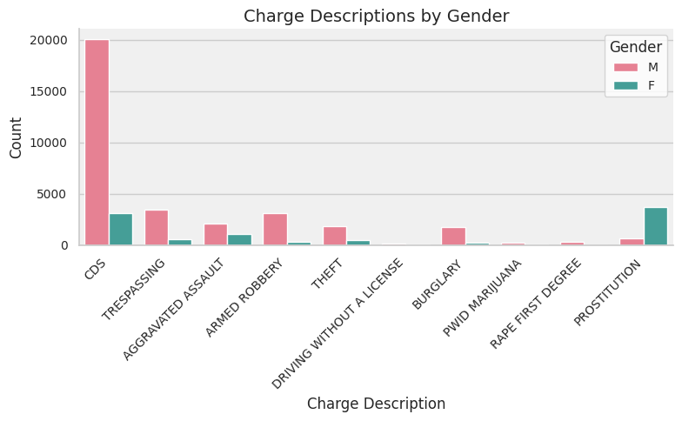
Charge Descriptions by Gender
Analyzing the frequency of each race category in the dataset
Identifying the race with the highest crime frequency
Creating a bar plot to visualize race frequencies

Slide 11
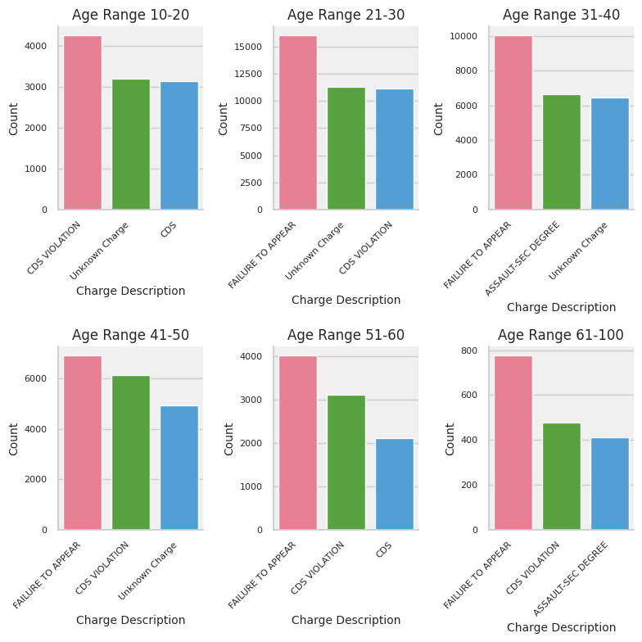
Age_Range vs Charge_description
Grouping the dataset by age ranges
Finding the top charge descriptions for each age range
Creating bar plots to visualize the top charge descriptions by age range

Slide 12
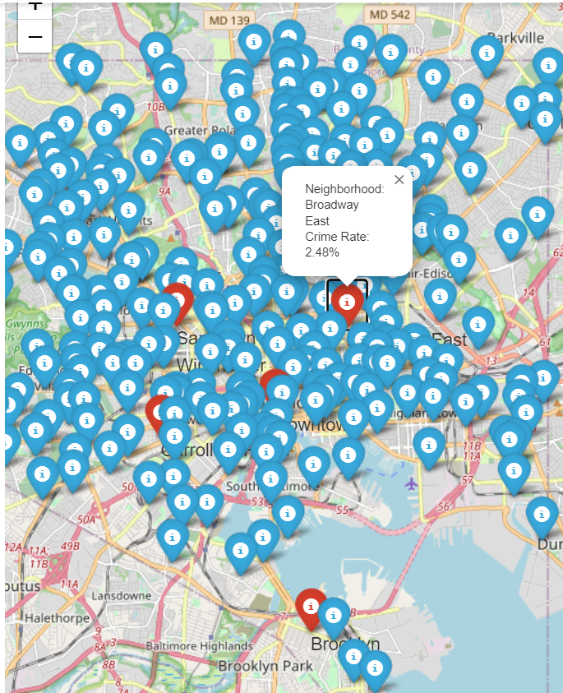
Baltimore city crime through maps
Calculating crime rates for each neighborhood
Selecting the top 5 neighborhoods with the highest crime rates
I used folium Map for visualization of map
Displaying the neighborhoods on a map with markers and crime rate information

Slide 13
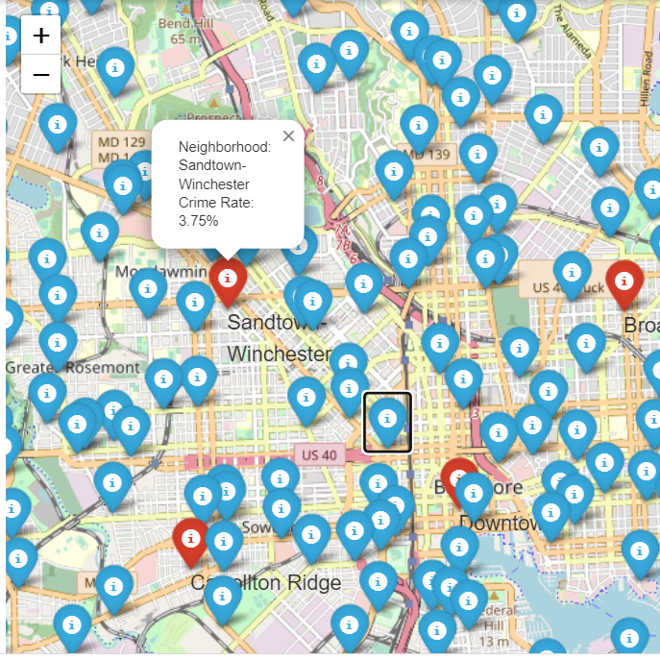
2nd Image

Slide 14
Thanks

